Slide 1
Front
Heidi
Jessie
Brenda
Linus
Jessica
Steven
Nicole
Waitlisted/
Auditors

Slide 2
Announcements
Ask us questions :) Join us at OH's: wdd.io/go/OH
Homework 4 will be up later tonight :)
Group project starts today
Team sign-up before end of Wednesday: wdd.io/go/project-signup
More will be posted on portal/Piazza & we'll talk about it more later today
For this week: You'll only need to form a group of 3
Midterms? Absence form: wdd.io/go/absence
If you receive 0 for homework 1, let us know!

Slide 3
Typography and Color More tools to convey emotion and information!
Week 4

Slide 4
Part 1 - Typography

Slide 5

Typography evokes the personality/character of the site.

Slide 6
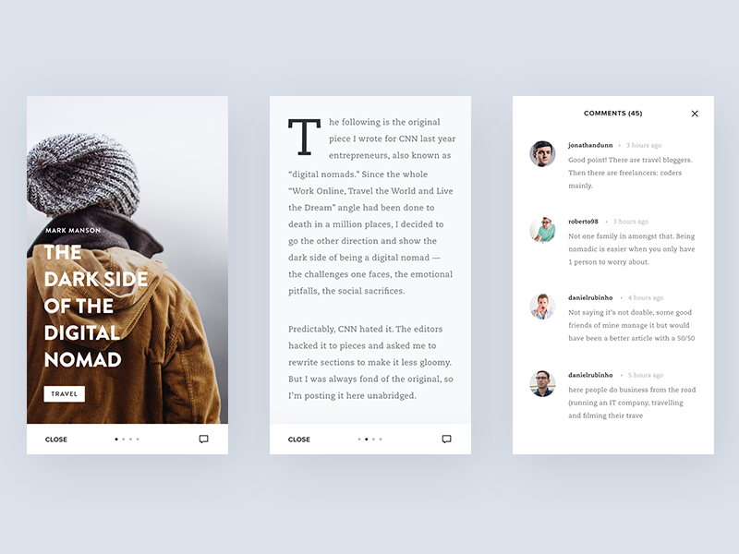
Often more than 80% of the information is expressed as pure text.

Slide 7
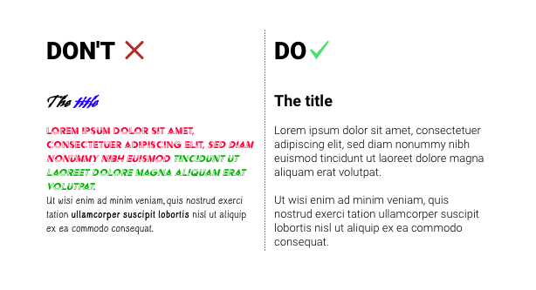
Readability is important! Both in the way we choose our fonts,

Slide 8
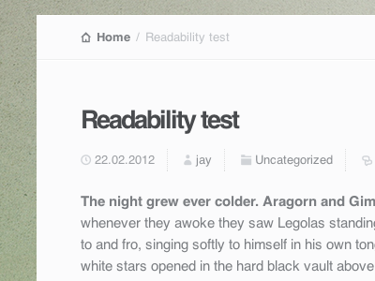
. . . and in the way we use size, weight, and color to display them.

Slide 9
Conveying Emotion with Type

Slide 10

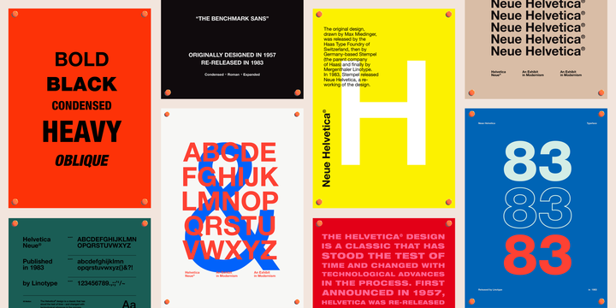
Type can be used to portray very different emotions.

Slide 11
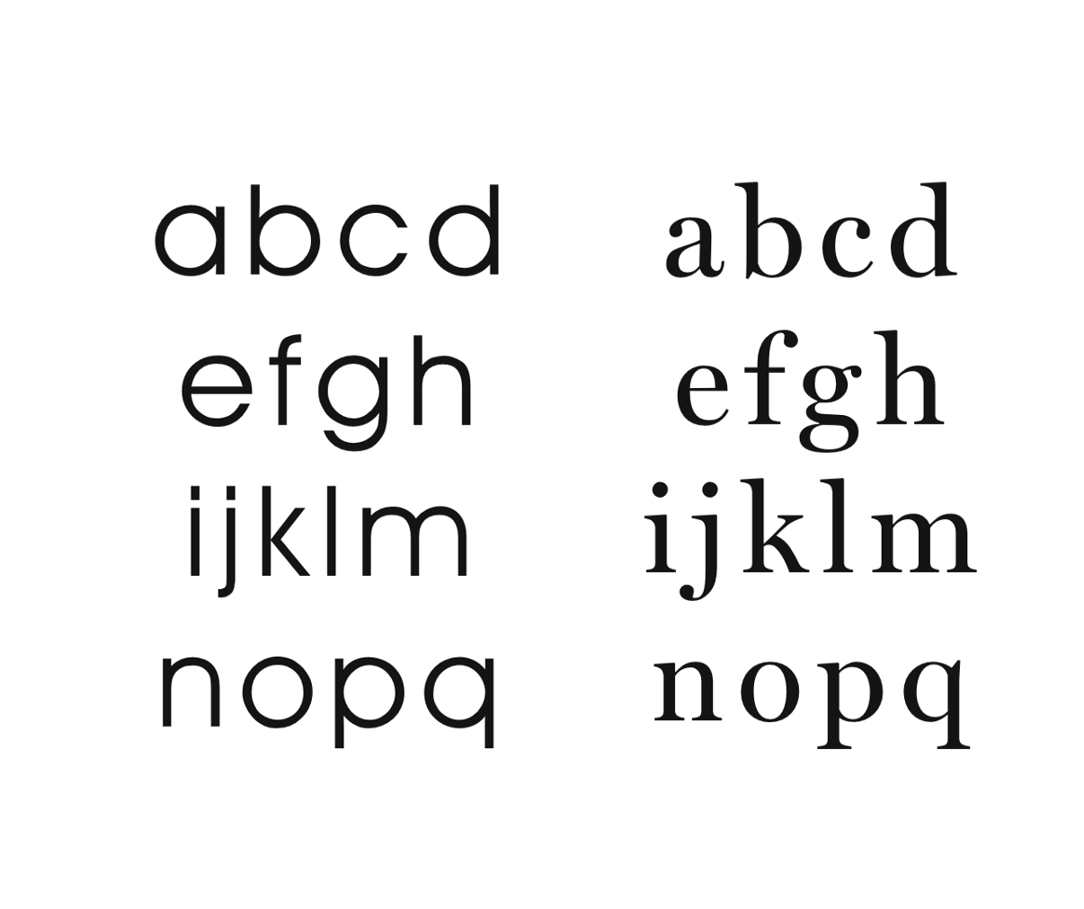
Font Families
Serif Fonts
Has a little flick where the letterforms terminate
Feels classy and formal
Times New Roman, default font without CSS
Sans-Serif Fonts
Does not have a flick
Feels modern
Arial, Helvetica Neue, Avenir

Slide 12
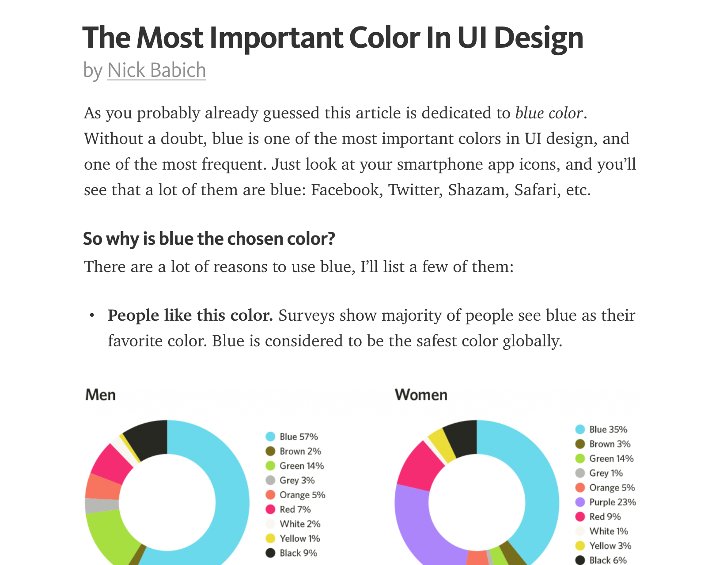
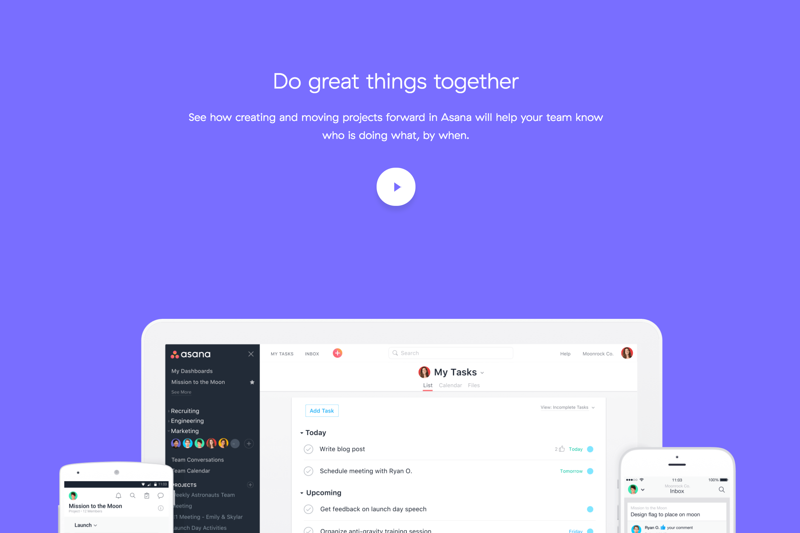
What font should I use for content?
Serif → text-heavy
Sans-serif → image-heavy

Slide 13
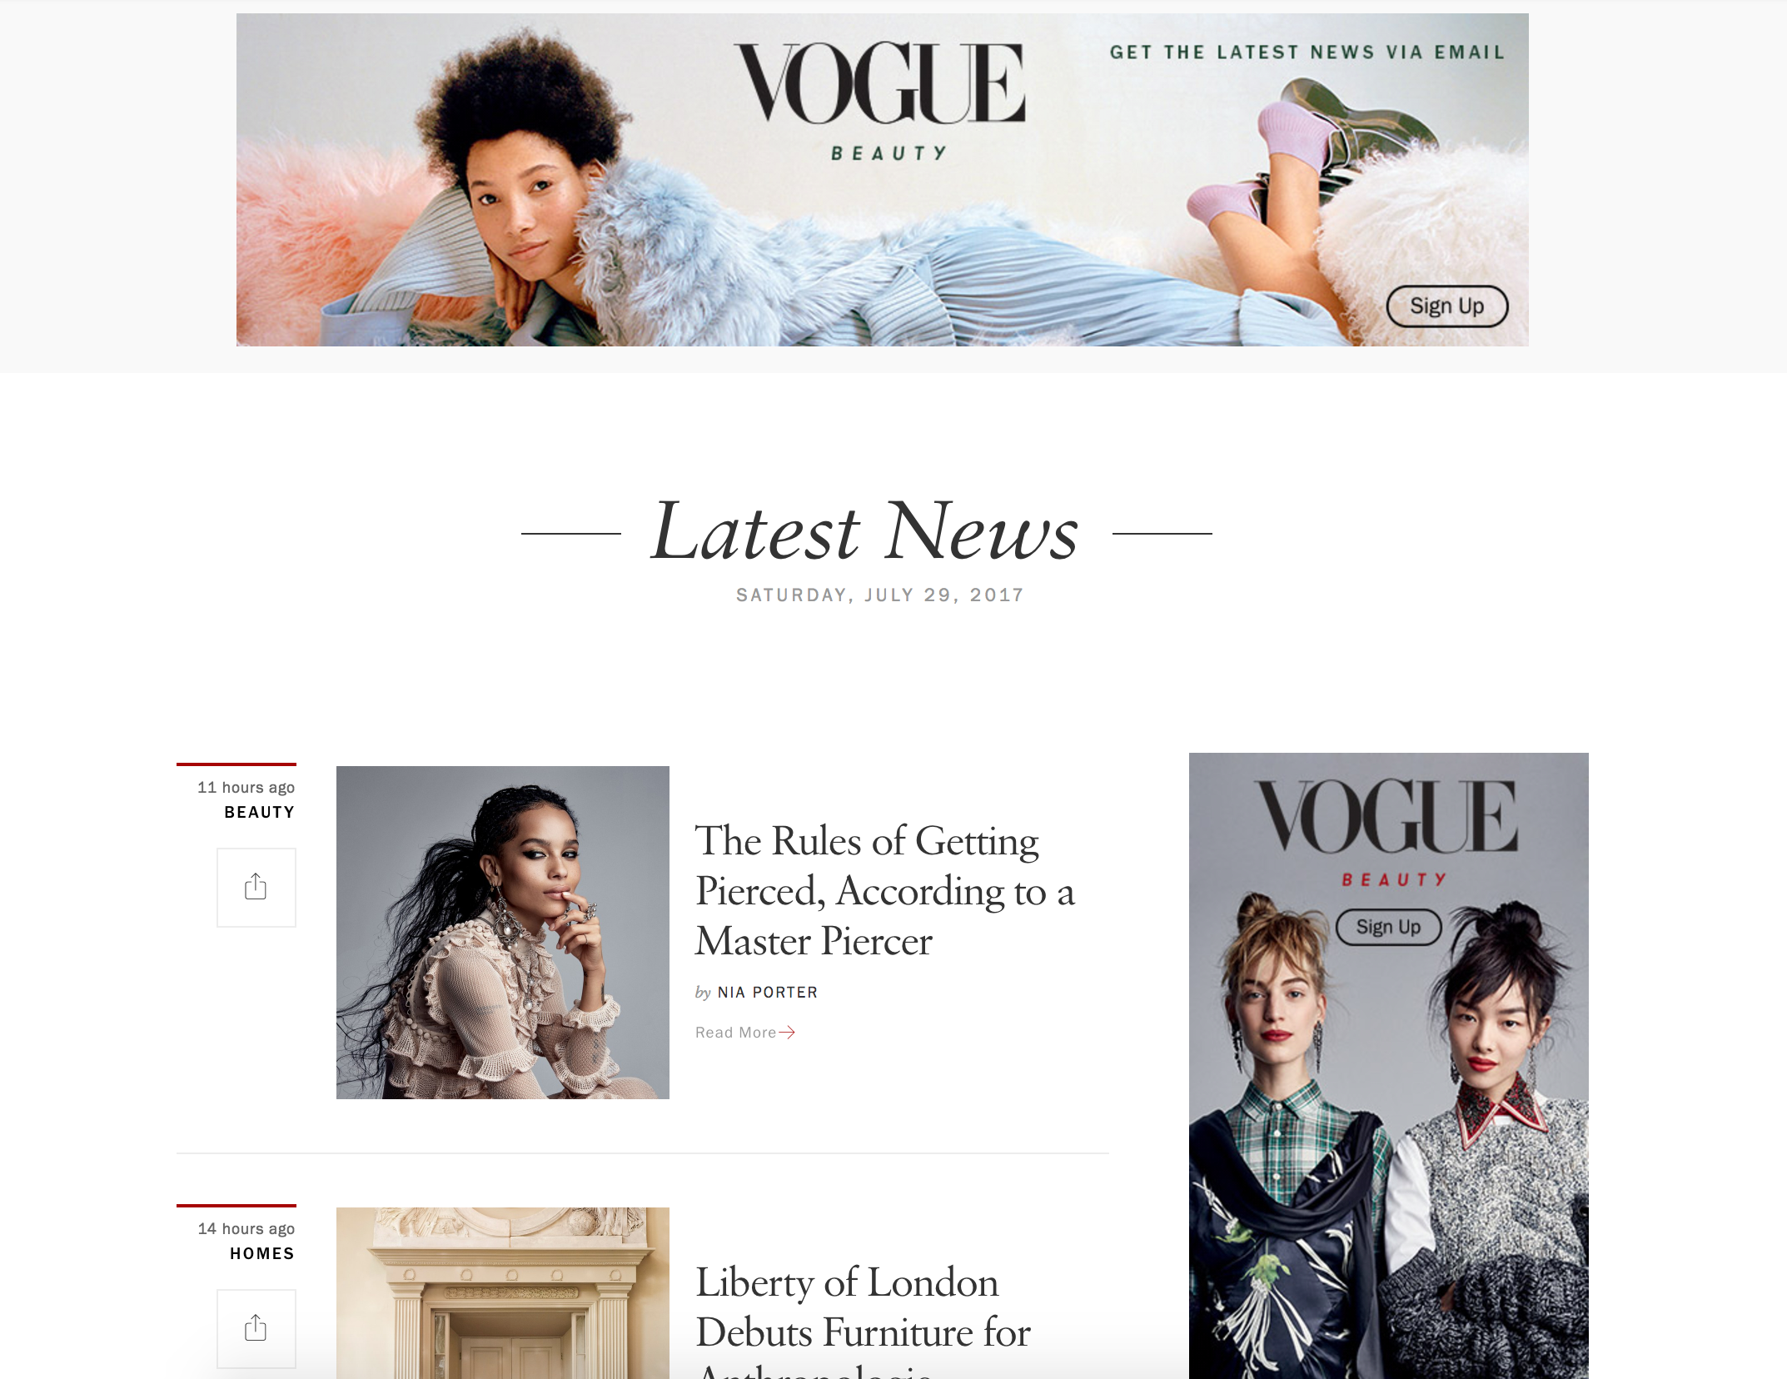
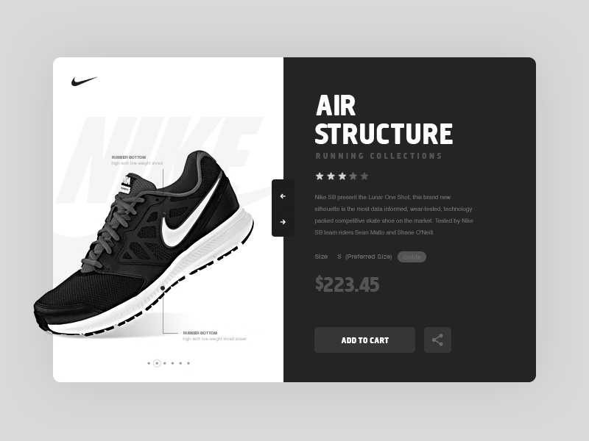
What font should I use for emotion?
Serif → classy
Sans-serif → modern

Slide 14
Generally, use 2-3 fonts per website

Slide 15
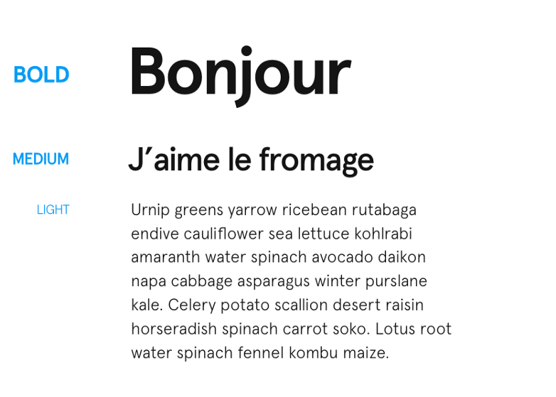
Use weights to create proper hierarchy, think of type as blocks.

Slide 16
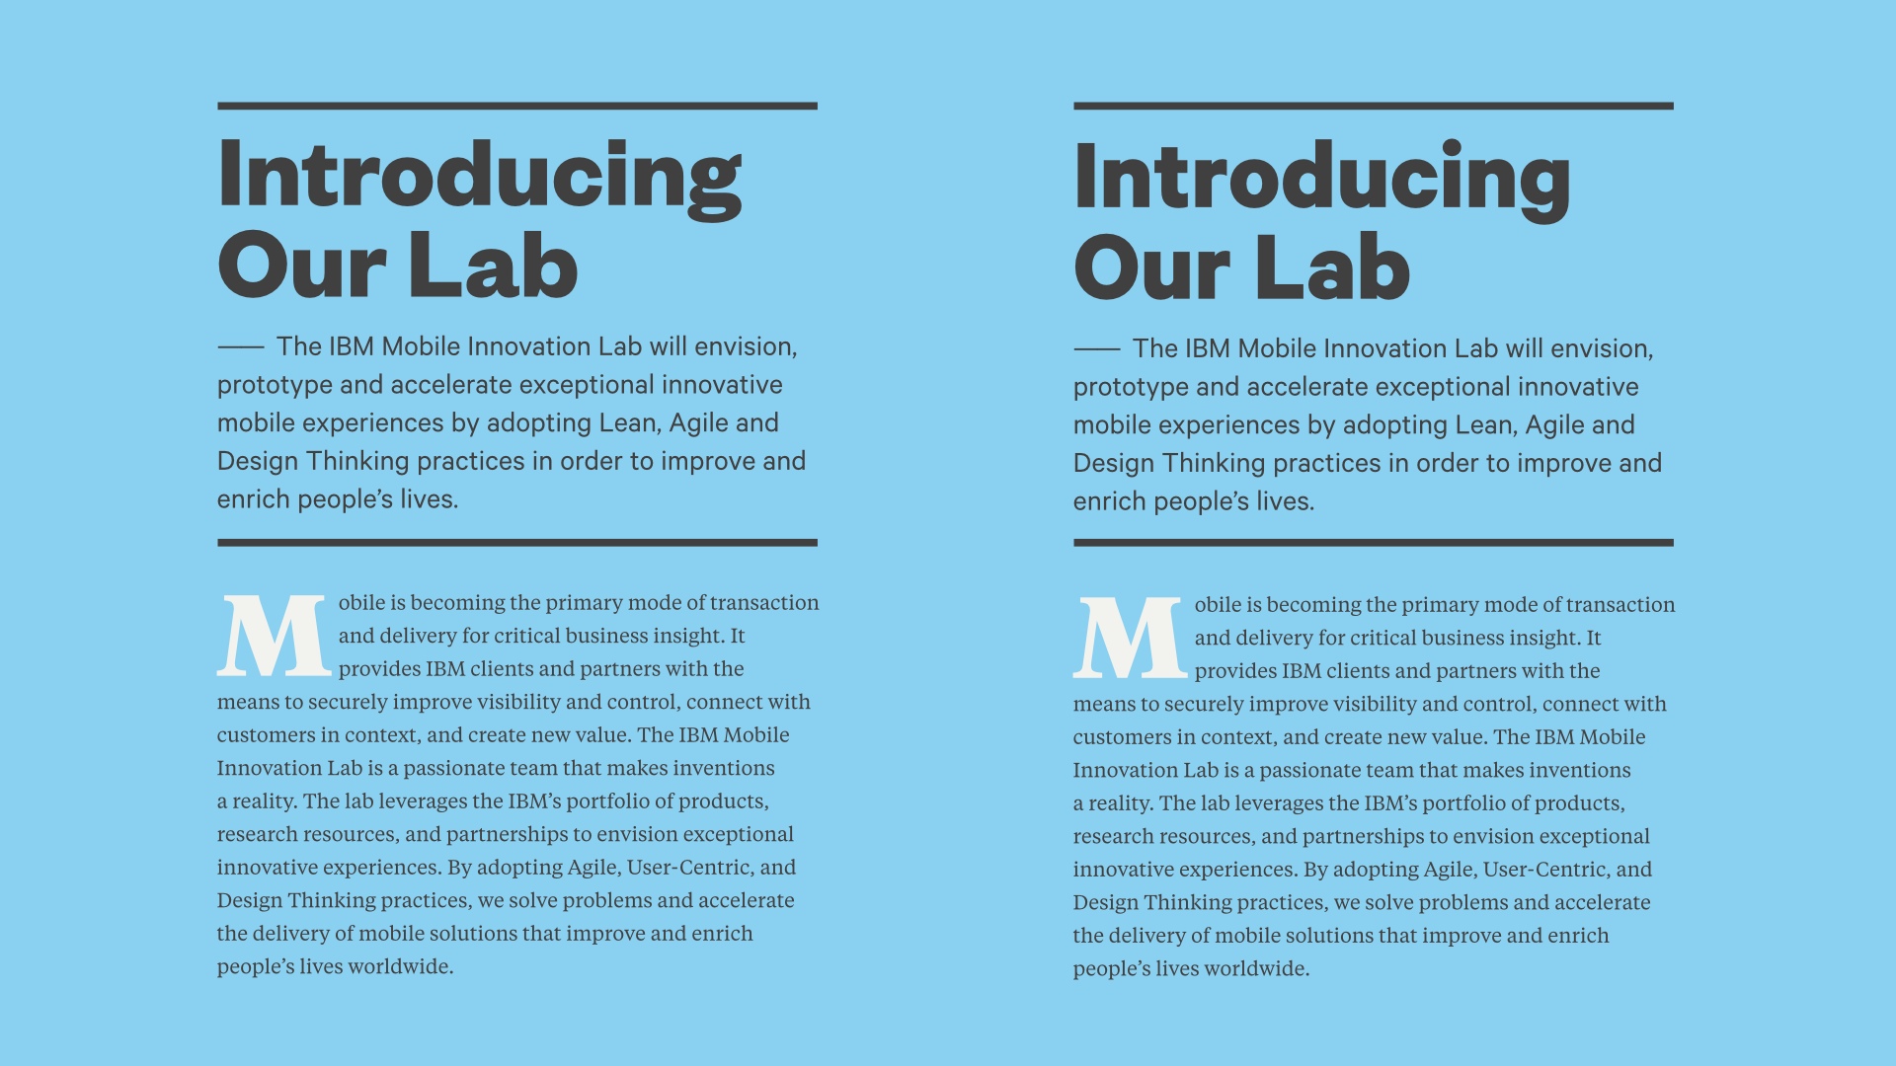
Mixing and Matching Fonts Properly

Slide 17
Type is not an exact science.
It is aligned when it feels aligned.

Slide 18
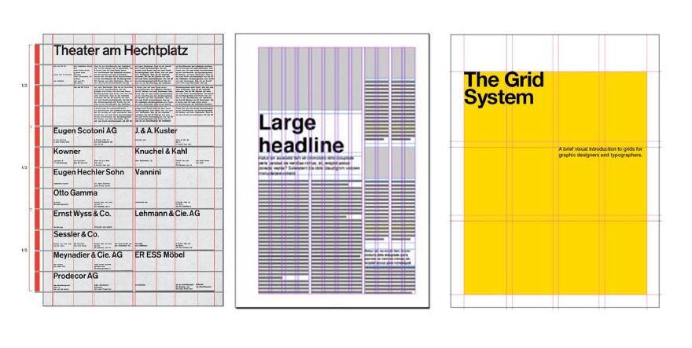
square grid
12-column
5-column
Grids can be useful! but,

Slide 19
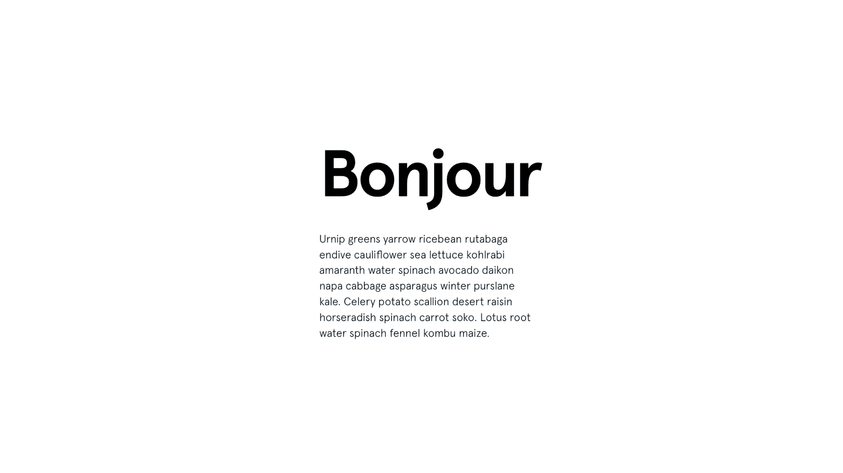
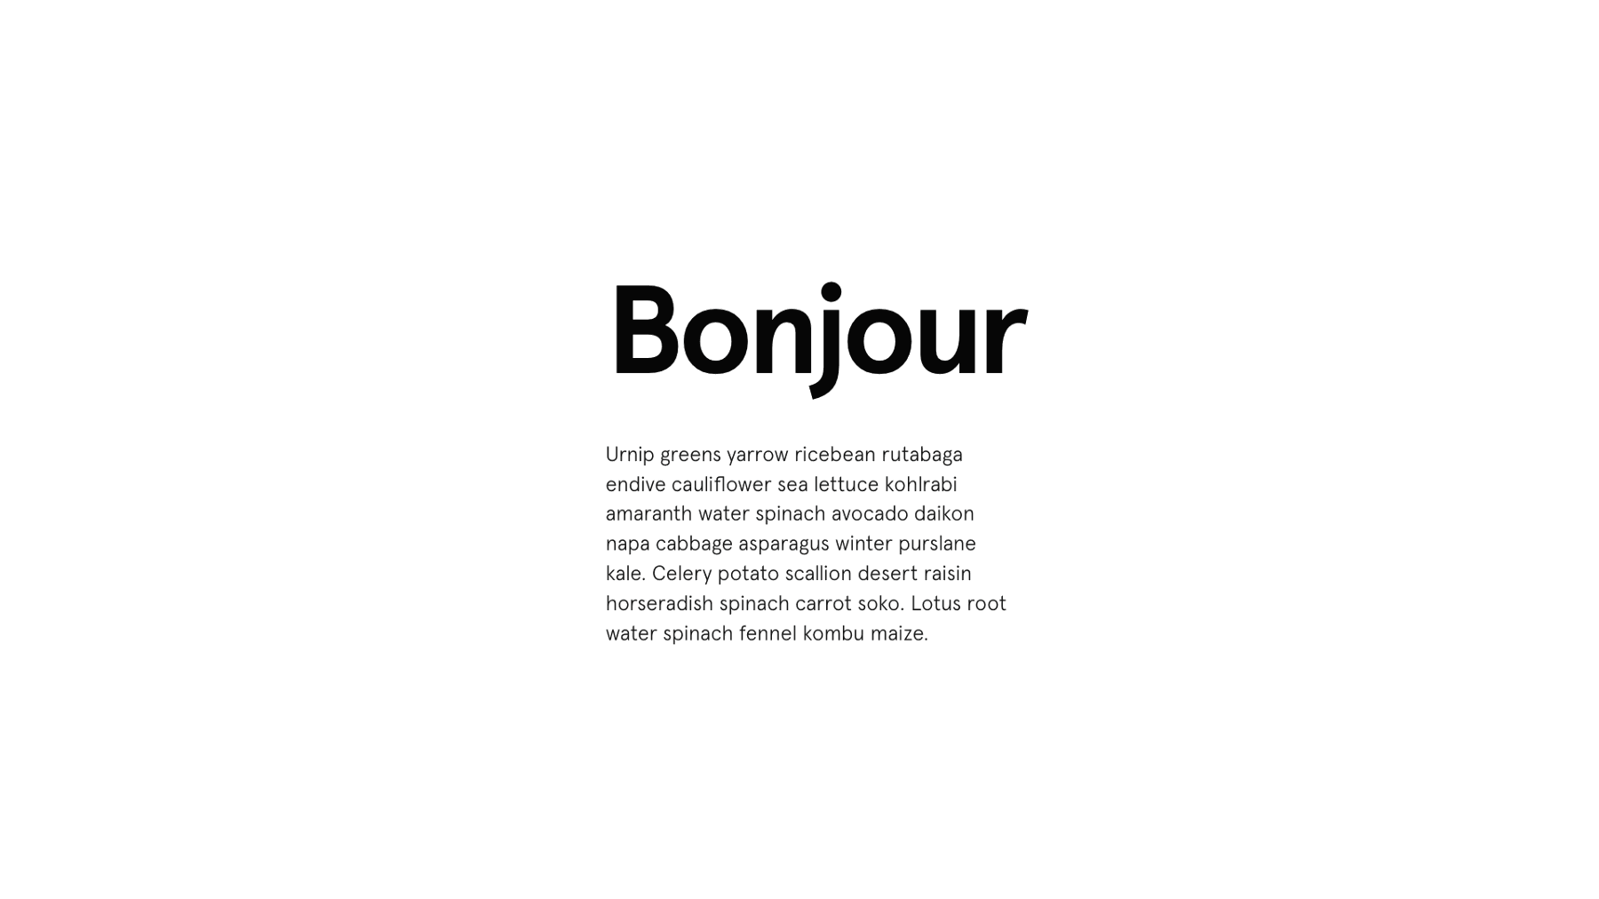
Sometimes, you just gotta eyeball it.

Slide 20
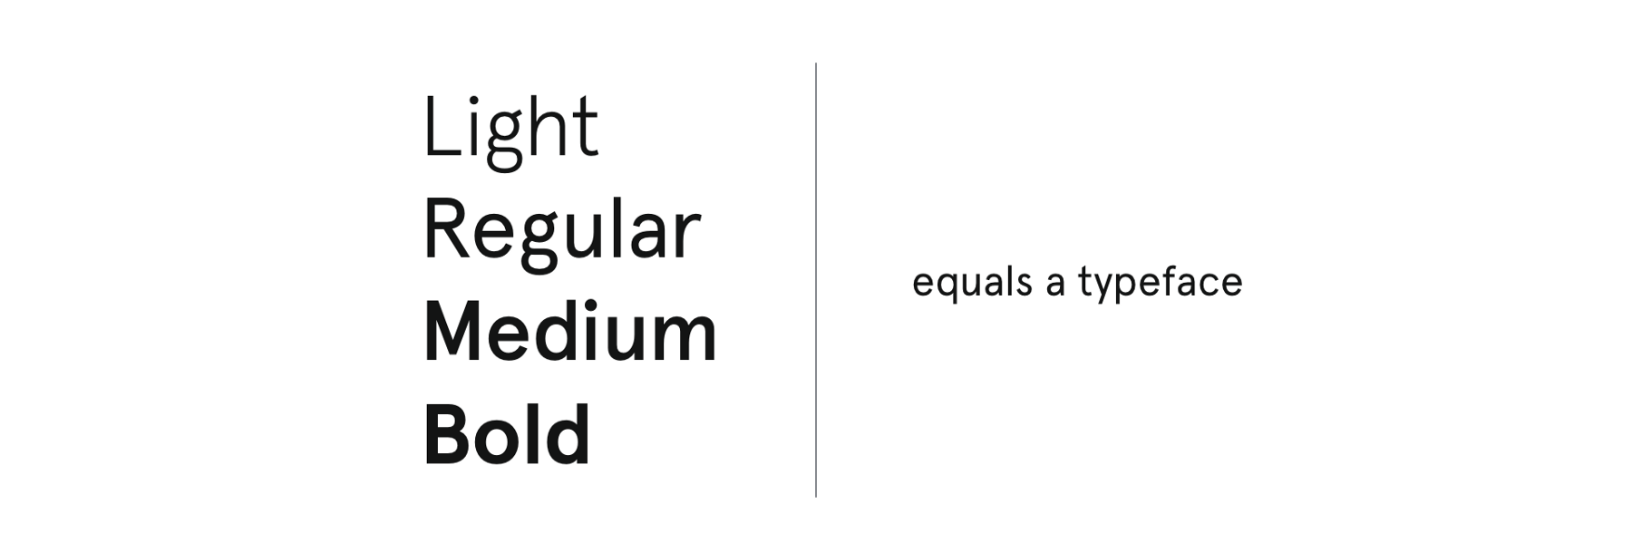
Pick a font that has a lot of weights.

Slide 21
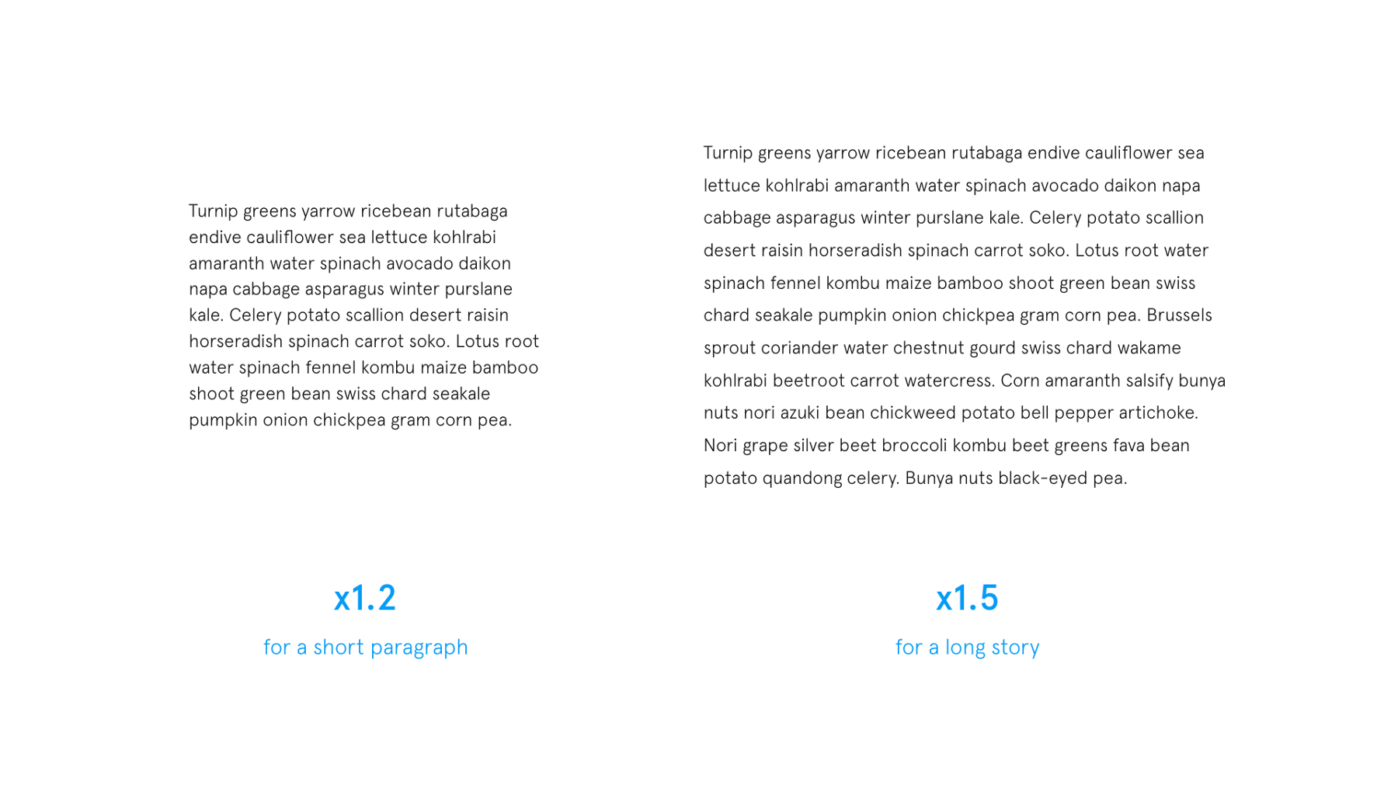
Use line-spacing between x1.2 - x1.5

Slide 22
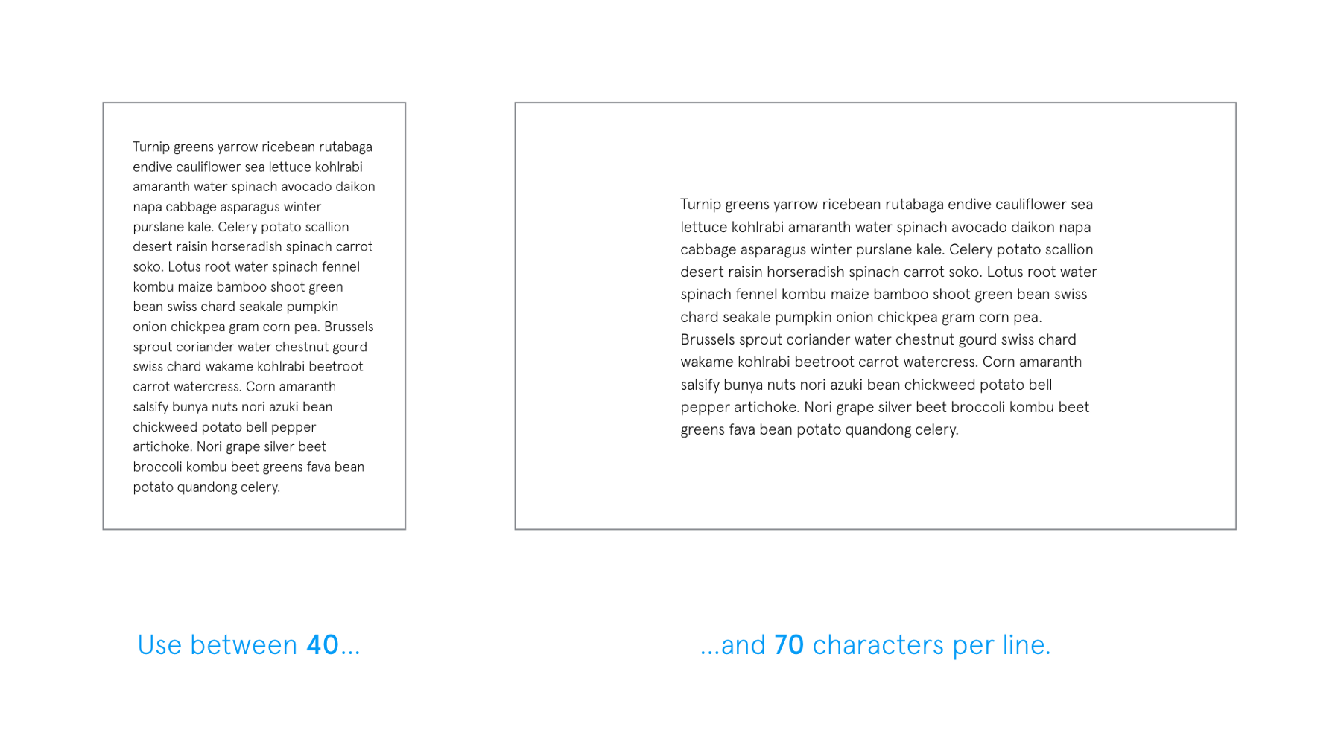
Cut down text width!

Slide 23
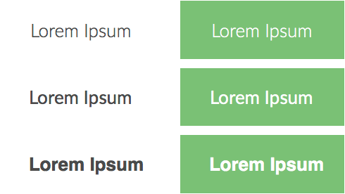
Use Contrast
Notes:
Example of the contrast between thin and thick fonts!
Thin fonts work better on darker backgrounds.
Example on the right: use white on colored/dark backgrounds
The thick white font on the green background doesn’t look very nice (at the bottom)

Slide 24
Use Contrast
Notes:
Example of the contrast between thin and thick fonts!
Thin fonts work better on darker backgrounds.
Example on the right: use white on colored/dark backgrounds
The thick white font on the green background doesn’t look very nice (at the bottom)

Slide 25
Okay, but how do a choose a font?

Slide 26
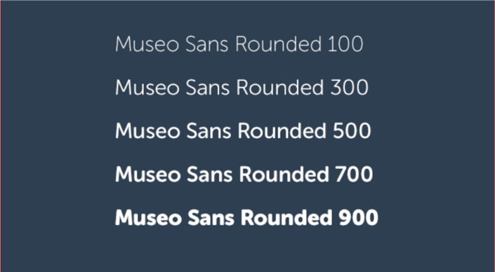
Number (100-900) determines font thickness
Start with one typeface.

Slide 27
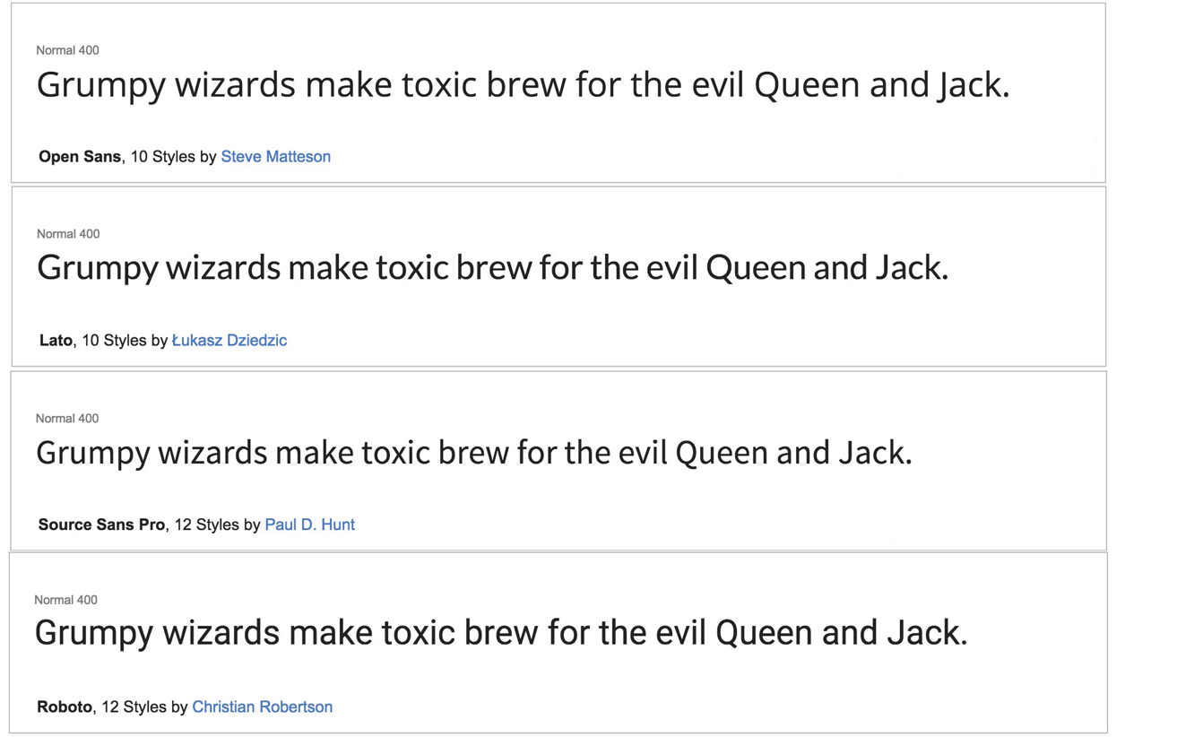
Use Google Fonts!

Slide 28
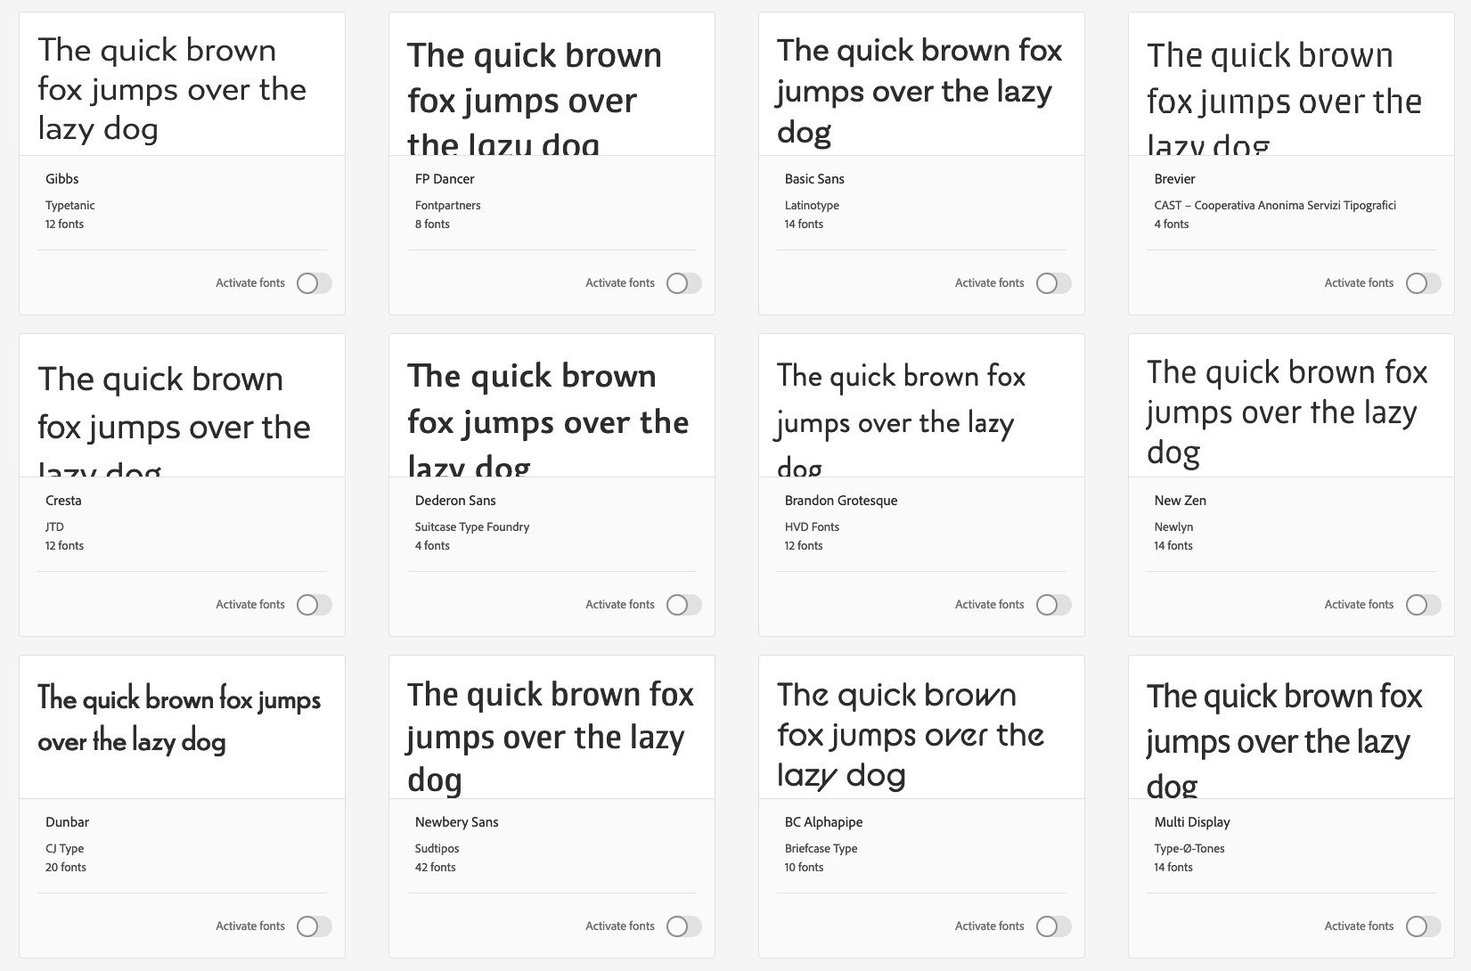
Adobe Typekit is really good, too.

Slide 29
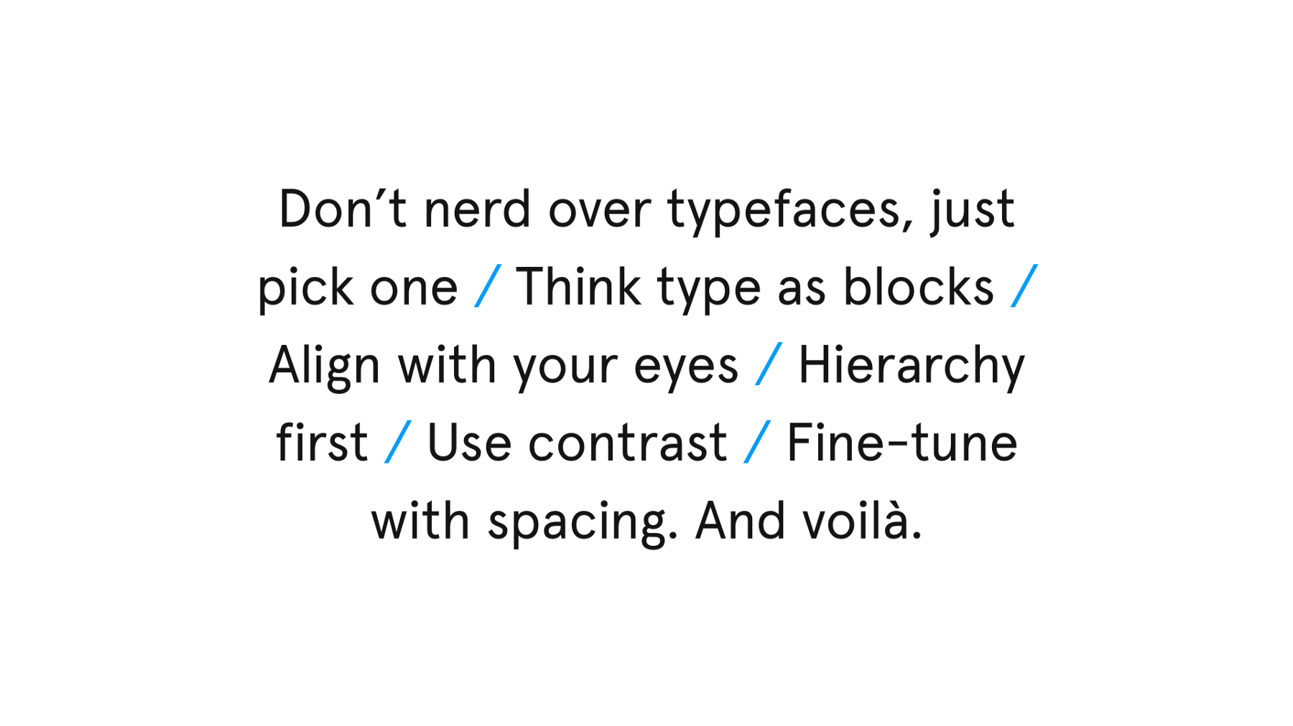
Source - tinyurl.com/y7xvudcu

Slide 31
Part 2 - Color
Notes:
Now we’re going to talk about some of the main ones
Side note: color and typography - that’s all you need to create a really nice minimalistic site -> very trendy!!!

Slide 32

When we talk about color, think about it like this.
Notes:
sorry not enough time to go through every color. Take a look! makes notes!

Slide 33
The three main components of color --
hue, saturation, and brightness.

Slide 34
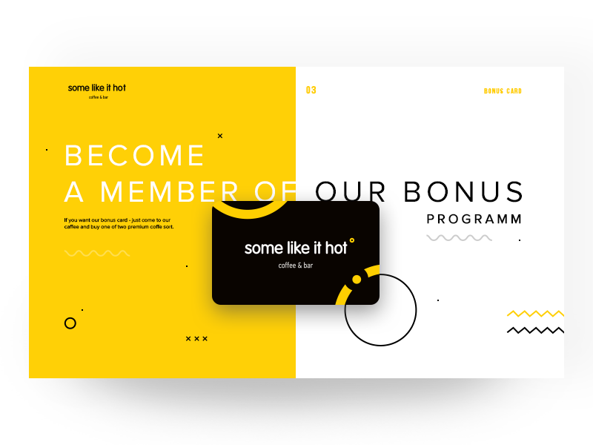
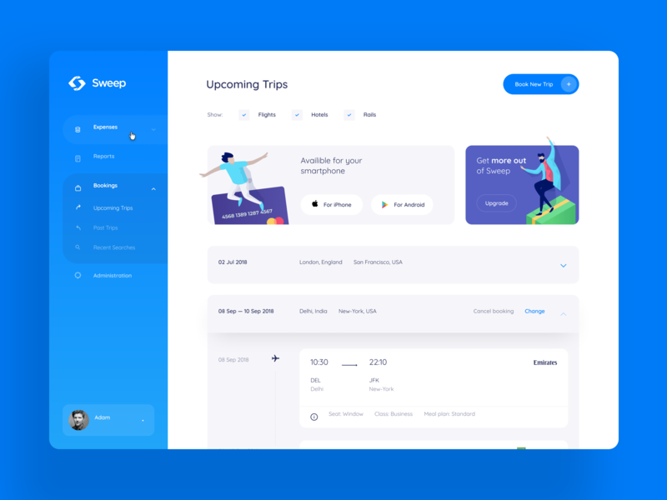
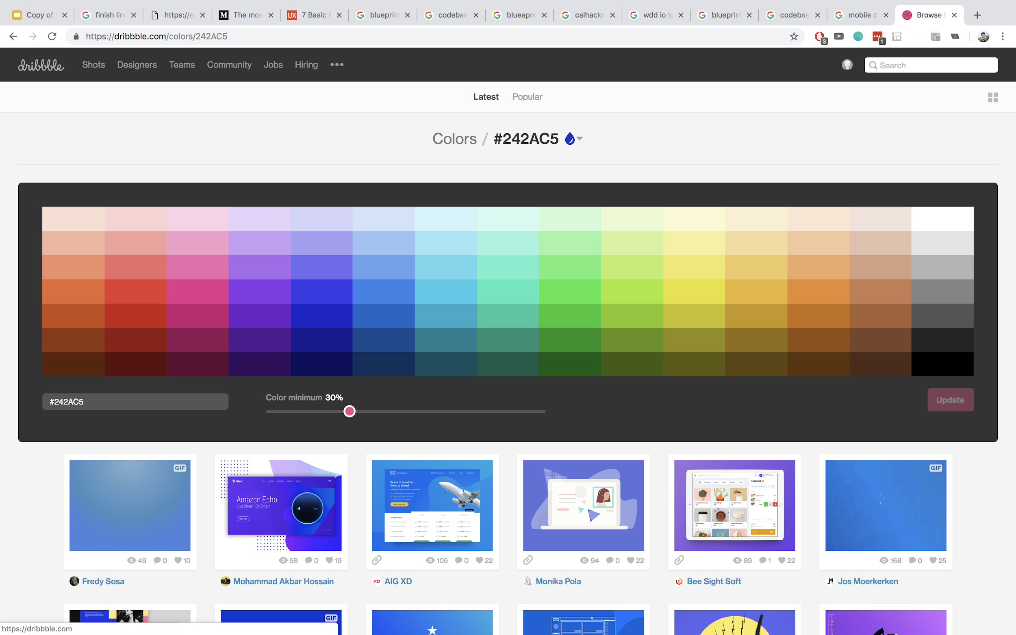
Hue -- what color it is.
Notes:
sorry not enough time to go through every color. Take a look! makes notes!

Slide 35
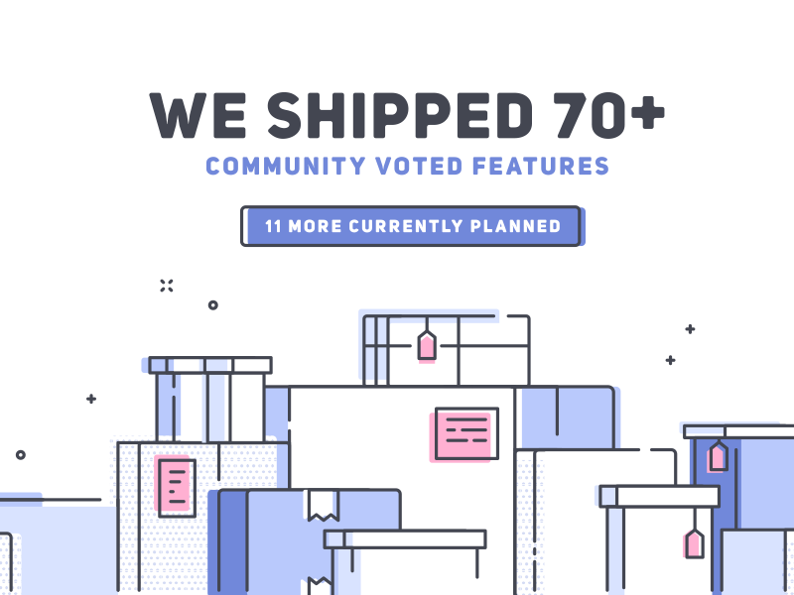

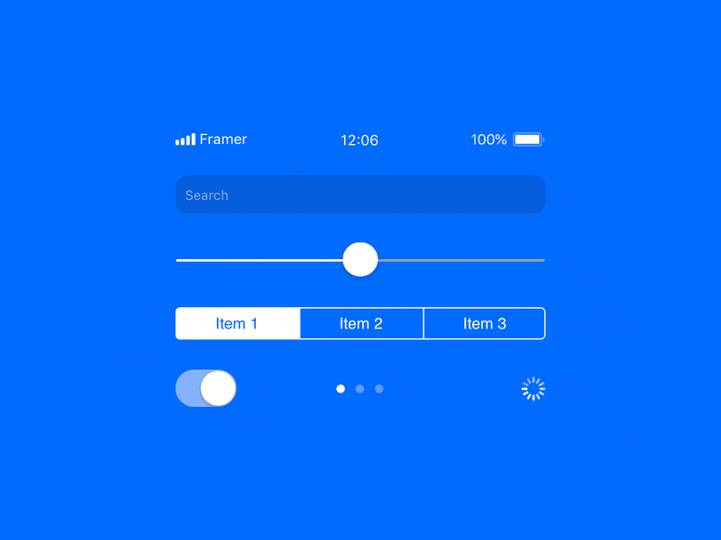
Saturation -- how much grey is mixed in, or how bold a color is.
Notes:
sorry not enough time to go through every color. Take a look! makes notes!

Slide 36

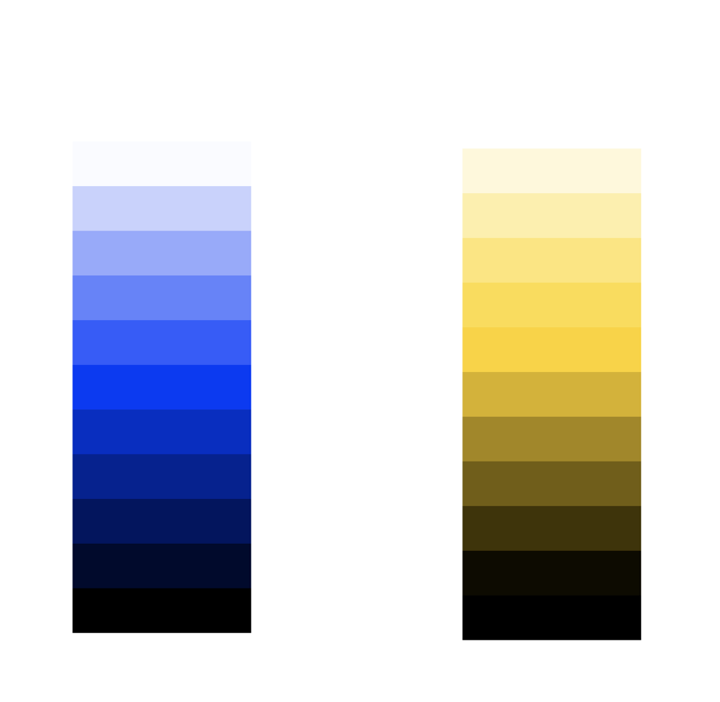
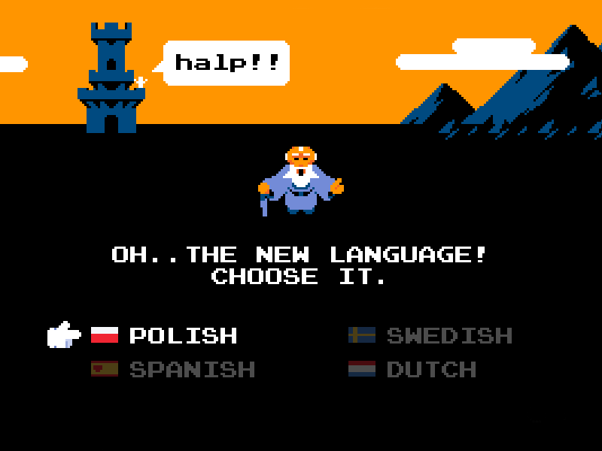
Brightness -- how much black is mixed in.
Notes:
sorry not enough time to go through every color. Take a look! makes notes!

Slide 37
Color can not only represent a color of a mood, but can also lead to people experiencing that mood.

Slide 38
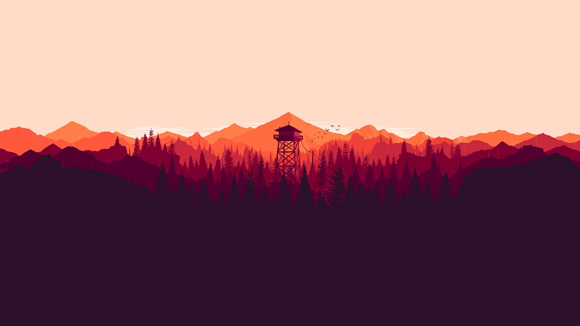


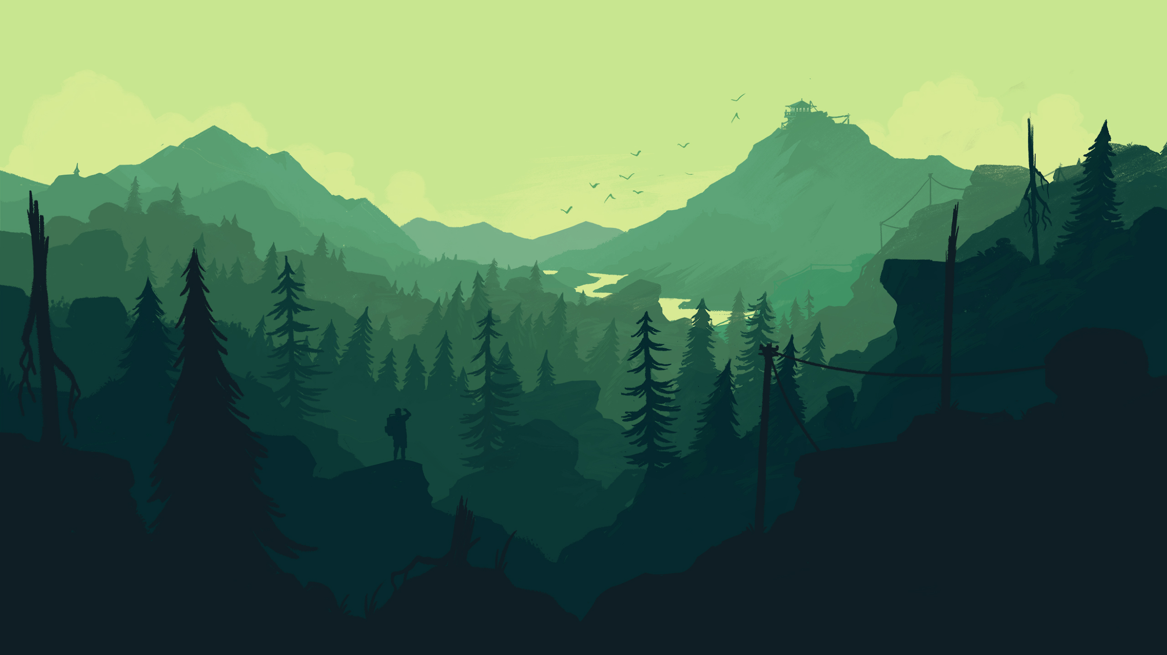
Color can often push an emotional narrative, useful for storytelling -- Firewatch
Notes:
sorry not enough time to go through every color. Take a look! makes notes!

Slide 39
It is in our users’ biological responses that connects colors to emotions.

Slide 40
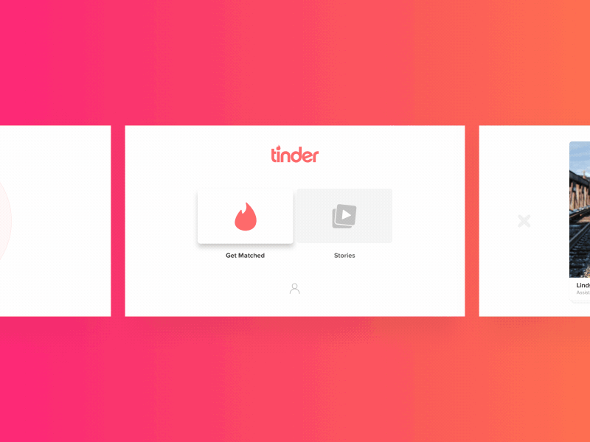
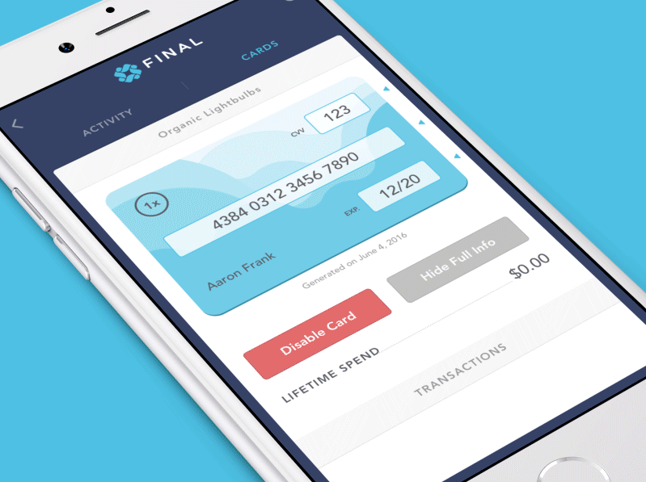

Red
Strong and Emotionally Intense Color
Can represent love, sexuality, or violence.
Incites “danger response”
Often used as an accent color rather than a main focal color
Red is noticeable, used for cancelling. Think stop, do not enter, or rejected password.
Notes:
“Different colors evoke different emotions” wow sounds FAMILIAR
First color that comes to mind is RED
One of the most important colors to humans
Red is the first color for languages universally
Very emotionally/perceptually strong
Not often used as a main background - would get very tiring
More often used as accent color
Used typically as stop/cancel color

Slide 41
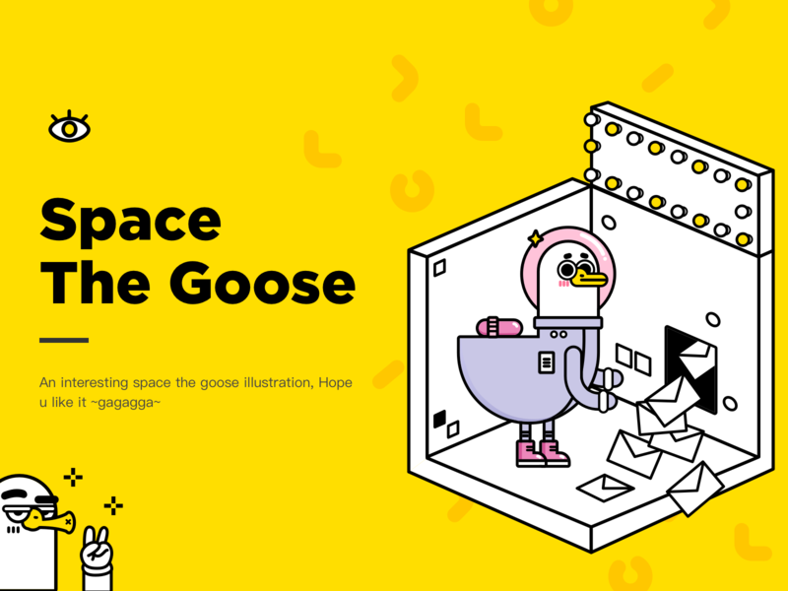

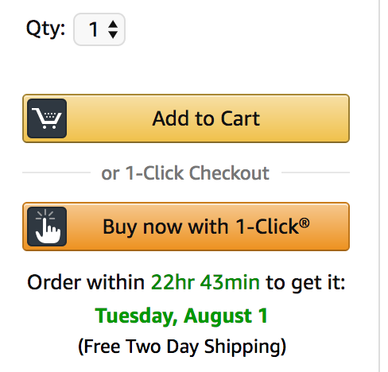

Yellow
Bright and creative color
Shopping websites - induces quick decision making
Prone to making text hard to read due to lack of contrast like this
Very widely used as a warning sign
Notes:
Super bright color
Also tends to be more of an accent color than background/text color
Background - gets tiring after a time
Text color - would be hard to read
Associated with trendiness + creativity
Buzzfeed!!! https://www.buzzfeed.com/?utm_term=.ohAXKl33Q#.osrGJRddM
It’s very vibrant + attention-grabbing
Big statement - we are a bold company!
Often used as a warning - ex: traffic lights

Slide 42
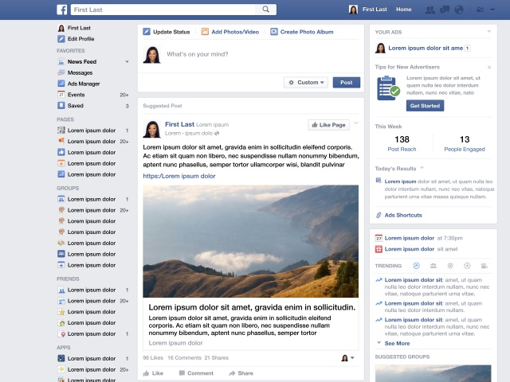

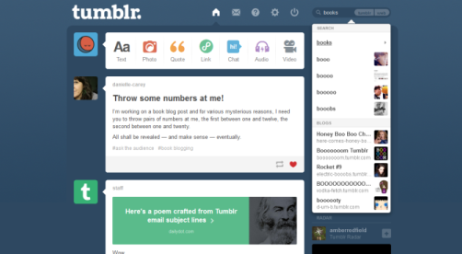
Blue
Reliable and calm color
Used for corporate audiences
Appetite “suppressor”
Suitable for many general-purpose websites
Notes:
Fun fact: blue is the most common favorite color
Neutral
Think blue jeans!!!
Much easier on the eyes than red or yellow
Can be used more on backgrounds because of this
Trust
Use on social media
FB, Behance, LinkedIn
Safe + reasonable choice, not going to offend anyone
Not going to break anything

Slide 43
Through a color’s cultural, narrative and psychological contexts, a designer can alter the meaning of their work and change its impact on users.

Slide 44
Use Dribbble to look at designs by color!
Notes:
sorry not enough time to go through every color. Take a look! makes notes!

Slide 45
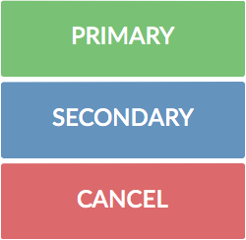
Color Scheme: Themes
Use 2-3 main colors for your website
Primary Color - theme for your website, navigation bar, logo icon, etc.
Secondary Color - an alternative accent, submit buttons, call to actions
Cancel Color - grab the user’s attention, warnings, cancel buttons
Notes:
Limit colors to 2-3 main ones
Keeps from being too crazy
Wdd.io
Three main colors
Having those three colors for different actions allows you to quickly differentiate b/w tasks you’re completing

Slide 46

Use transparency to de-emphasize elements!

Slide 47
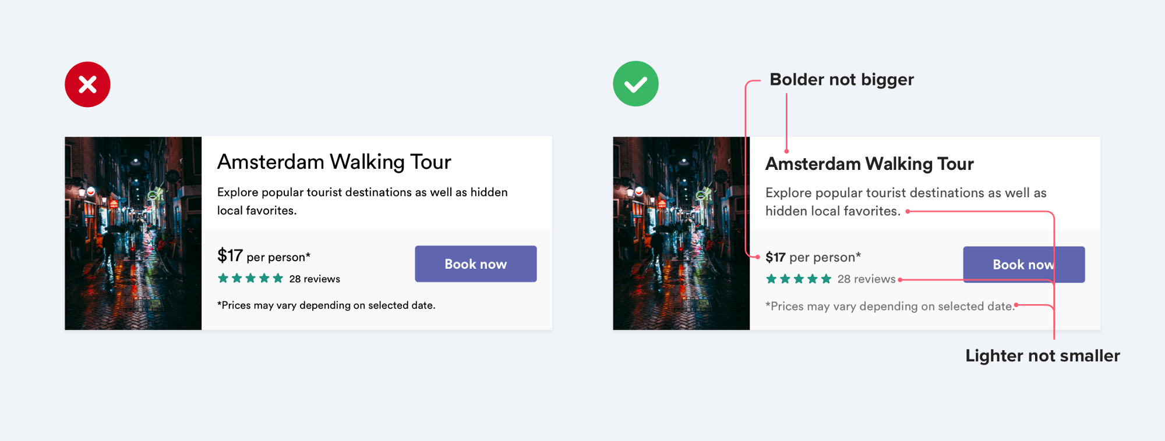
Use color and weight to create hierarchy instead of size
Notes:
theres only so much font size you can go until theres nothings smaller and its harder to read

Slide 48
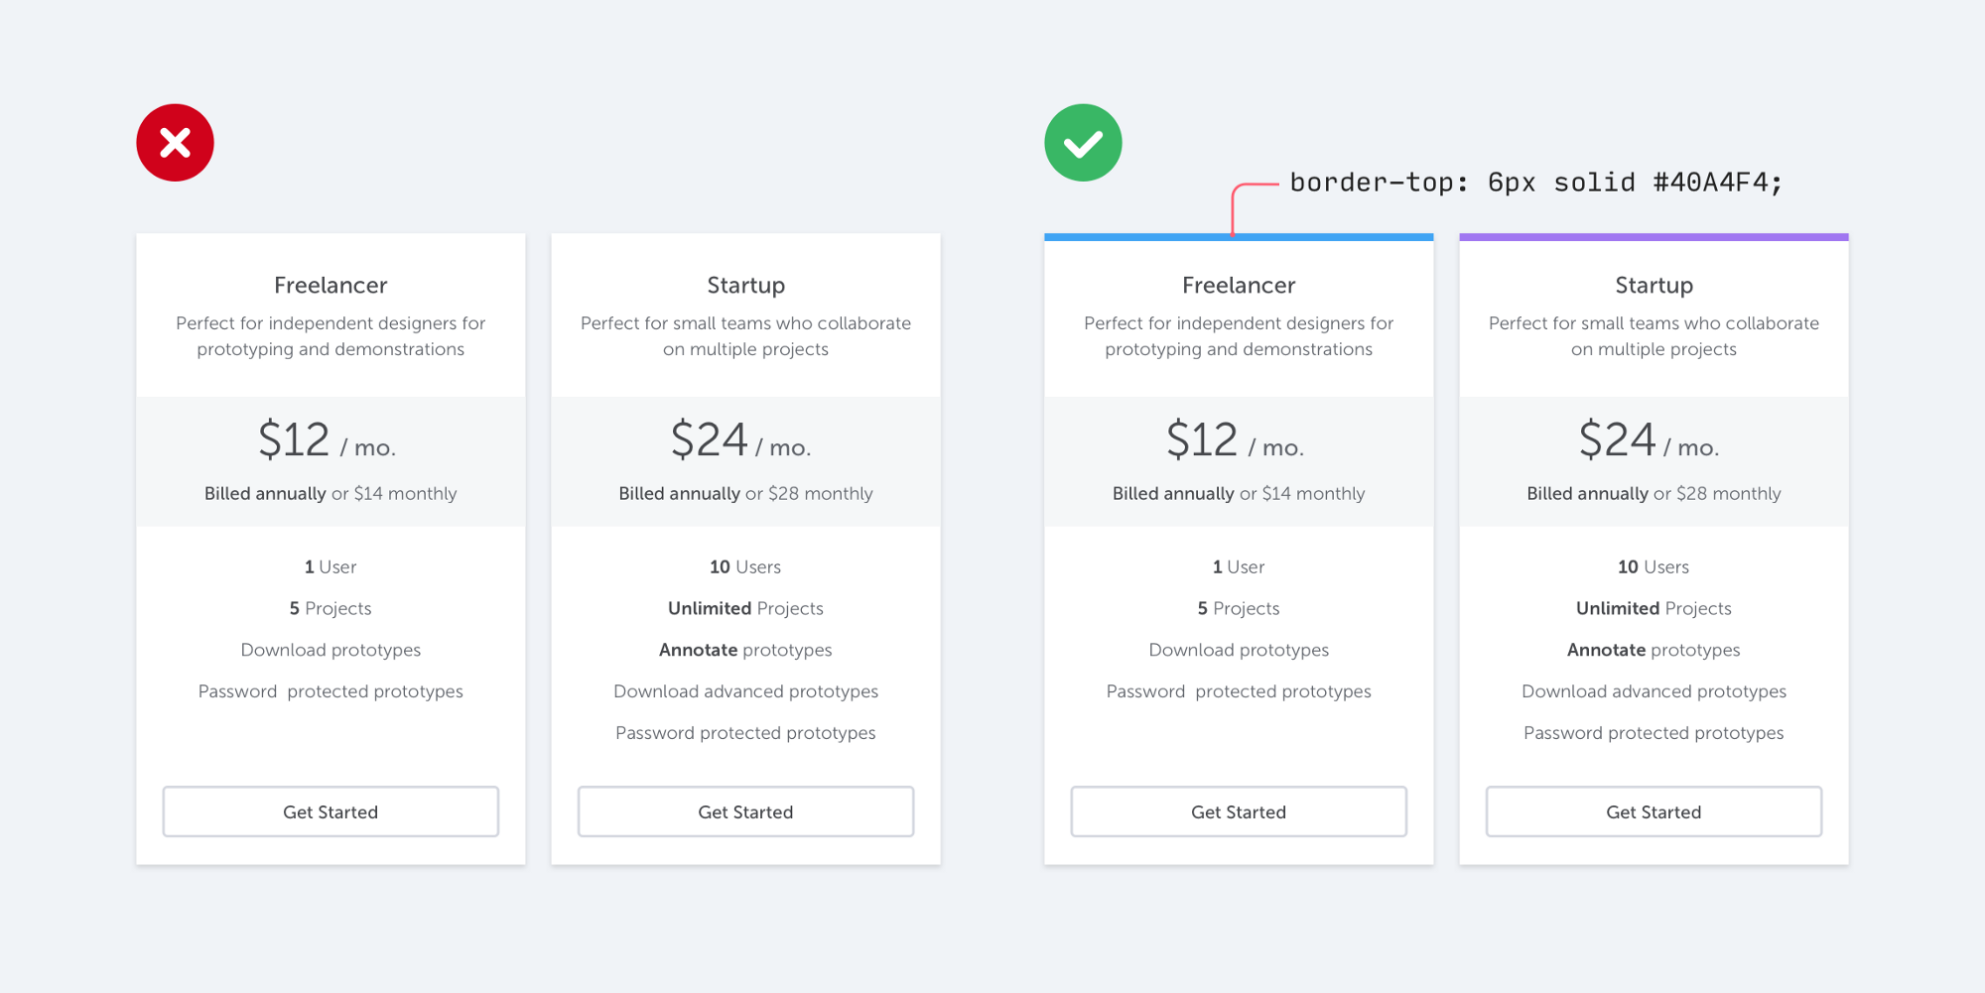
Colors can be used as accents!
Notes:
It doesn’t take any graphic design talent to add a colored rectangle to your UI, and it can go a long way towards making your site feel more “designed.”

Slide 49
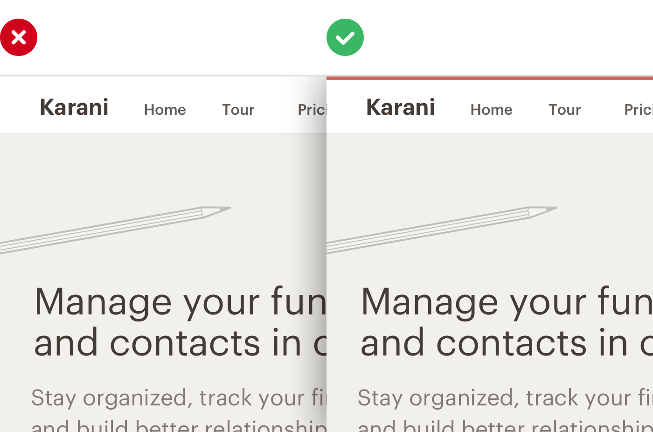
You don’t have to go too overboard with color.
Notes:
It doesn’t take any graphic design talent to add a colored rectangle to your UI, and it can go a long way towards making your site feel more “designed.”

Slide 50
Also, no one actually uses pure black
(Use #333 instead)
Notes:
Very things in the natural world are pure black and so using #000000 in your designs will come off as harsh and unnatural.

Slide 51
Use Contrast
Notes:
When you’re working with typography + color, think about legibility, not just aesthetics
Also color on white!
Main point: AVOID BLACK ON COLOR!!!
Most of emphasis is established by providing strong contrast between colors

Slide 52

Okay, but how do I pick a color?

Slide 53
Don’t sweat it. Use coolors.co
Or gradients.io for gradients.

Slide 54
Think you know your colors?
Try colorbox.io by Lyft

Slide 55
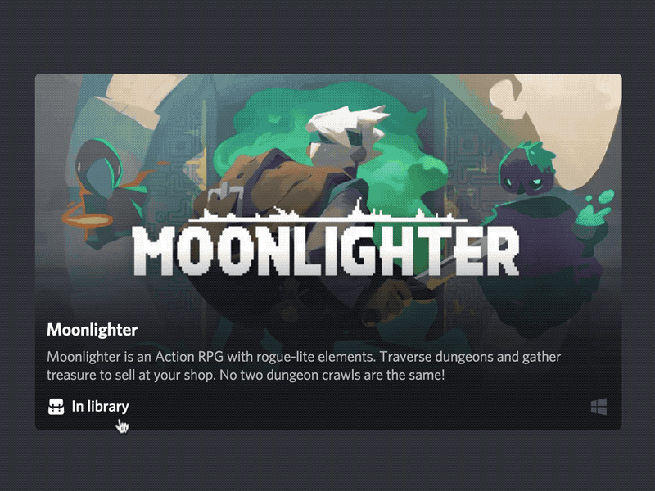
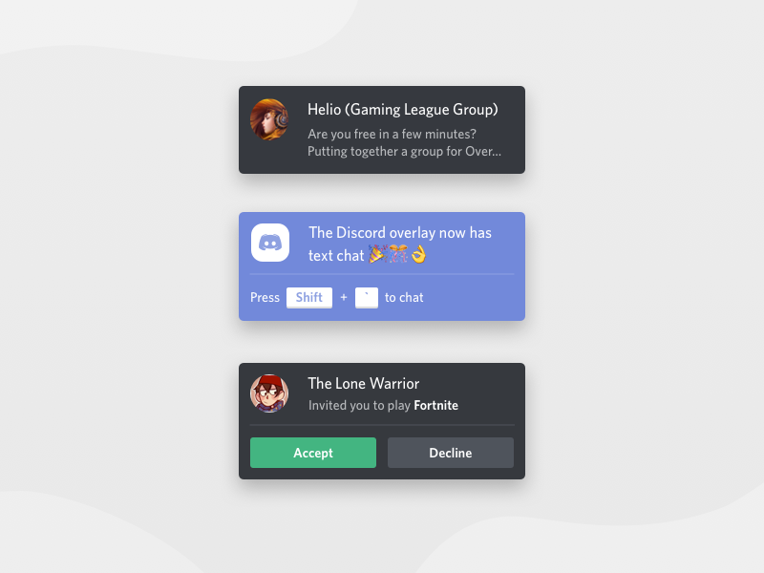
Putting it all together -- Discord.gg
Notes:
Examples of how white on color is effective. black on color less so, and color on black is nice.

